Slide 1


Website & App Interface Design: A Case Study
GitHub Website : https://github.com/
Instagram App : https://instagram.com/
By - Ajay Jawade | RollNo - 2202425

Slide 2

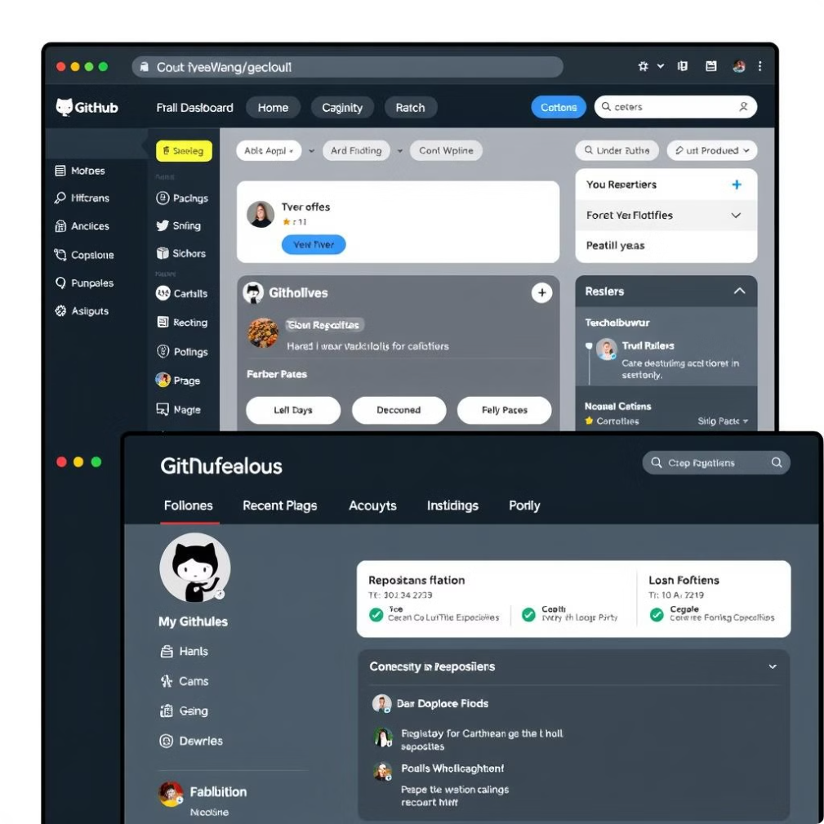
Good Design Aspects of GitHub
1
Visually Appealing UI/UX
2
Intuitive Navigation
Simple, smooth, and easy to navigate.
Attractive homepage and well-designed interface.
3
Accessible Dashboard
4
Comprehensive Profile Page
Quick access to repositories, chatbot, and updates.
Clear display of user activity and repository access.
5
Customizable Themes
Personalize the visual experience with theme options.

Slide 3

Bad Design Aspects of GitHub
1
Missing Password Confirmation
2
Inconsistent UI Elements
The absence of password confirmation increases the risk of input errors during account creation.
The registration page has a better design compared to the login page, leading to an inconsistent user experience. Maintaining uniformity across both pages would enhance usability.
3
Difficult Theme Setting Access
4
No Search Box for Settings
The theme preference setting is not easily accessible; a prominent light/dark mode toggle would enhance usability.
There is no dedicated search box to quickly locate specific settings, making it difficult for users to find and modify configurations efficiently.
5
Missing Bottom Navigation Bar
The lack of a bottom-of-page navigation bar hinders quick access to contact information and other essential links.

Slide 4

Good Design Aspects of Instagram
1
Easy Access and Navigation
2
Efficient Message Sorting
The main screen offers instant access to core features: home feed, search, Reels, posting, and user profile, all intuitively placed for seamless navigation.
Instagram allows users to efficiently manage their inbox with easy sorting of messages based on priority or sender.
3
Intuitive Navigation with Gestures
4
Readily Accessible Post Settings
Users can quickly navigate to messages with a simple swipe and effortlessly view stories, enhancing the browsing experience.
Instagram provides convenient access to common post settings directly on the posting screen, simplifying adjustments and customizations.
5
User-Friendly Gestures for Interaction
Engage with content using intuitive gestures: double-tap to like, swipe through photos in a carousel, and swipe down to effortlessly refresh the feed.

Slide 5
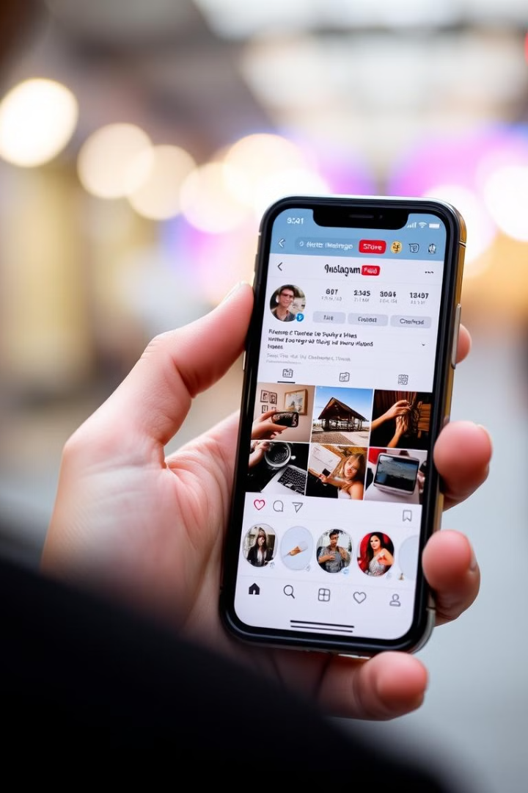
Bad Design Aspects of Instagram
1
Disorganized Settings
2
Overloaded with Infrequently Used Features
Finding specific settings can be difficult and time-consuming.
The interface includes features that are rarely used, adding unnecessary complexity.
3
Lacks Accessibility Features
4
Unnecessary Ad Button
Limited voice automation hinders usability for users with disabilities.
The prominent "Ad" button on the message page is rarely relevant to users.
5
Unclear Separation of Following and Favorites
The distinction between "Following" and "Favorites" is easily missed; a clearer visual separation is needed.

Slide 6

Conclusion
This design review has identified critical areas for interface enhancement on both the website and app.
Addressing these design flaws while capitalizing on existing strengths will substantially improve user satisfaction and overall engagement.

